Slide 1
Goal: Coding for Identifying Load Signature

Slide 2
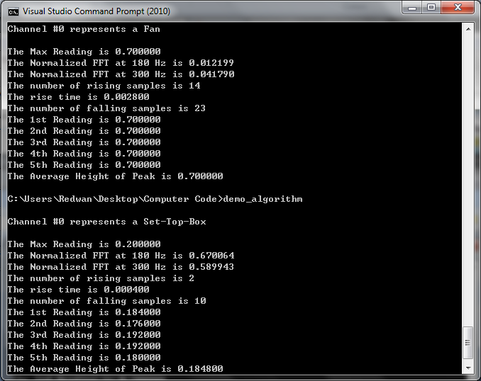
Finding Maximum and Average Peak Value
Average value of the first 5 peaks

Slide 3
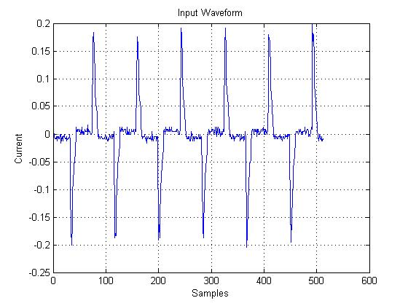
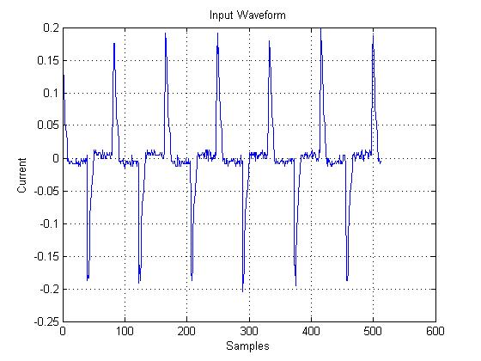


Phase Shift (MATLAB)
Before Phase Shift
After Phase Shift

Slide 4

Fourier Transform:
Fourier Transform:
Three important parts of FT:
  Normalized Values
  Real Components
  Imaginary Components
Normalized values are the same when we shift the phase. However, real and imaginary components are different.

Slide 5
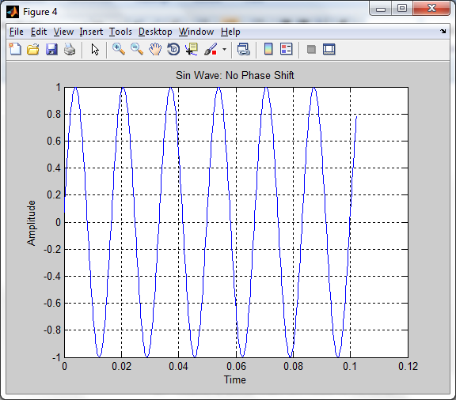
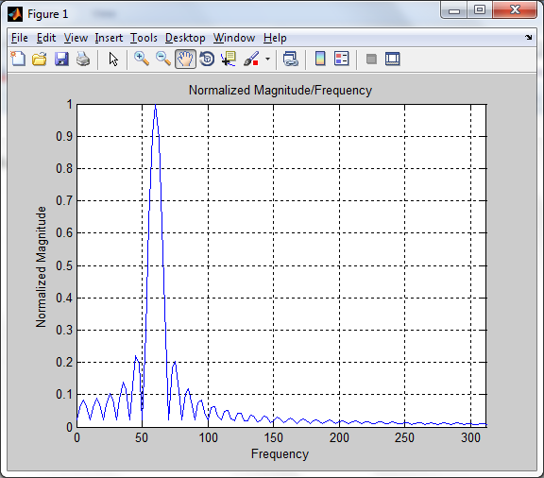
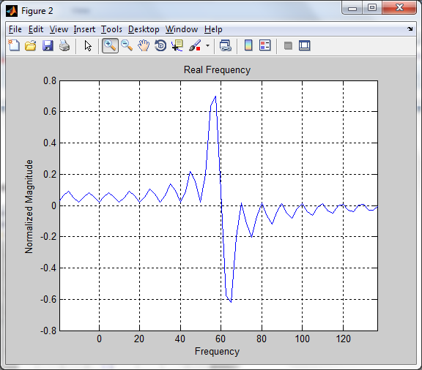
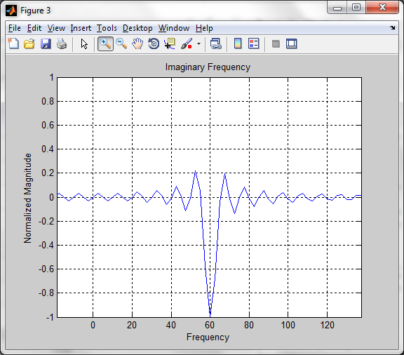
Sin Wave, Frequency 60 Hz and Phase Shift = 0
WaveForm:
Normalized FFT:
Real Component:
Imaginary Component:

Slide 6
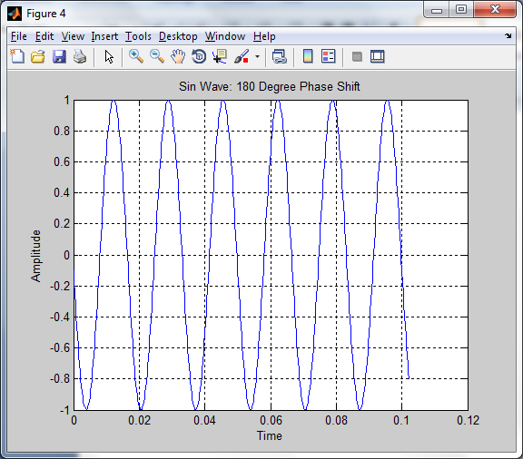
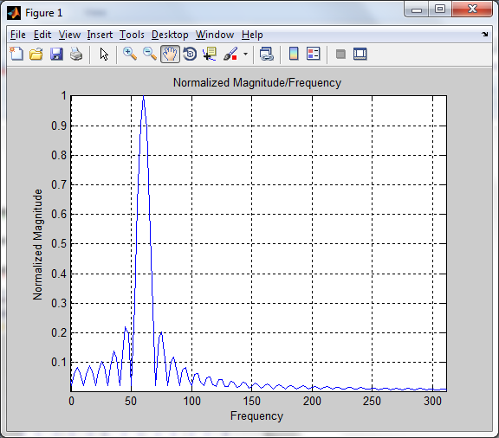
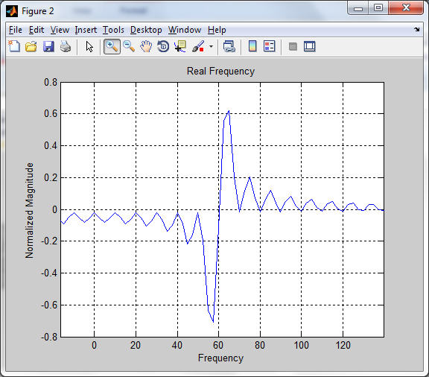
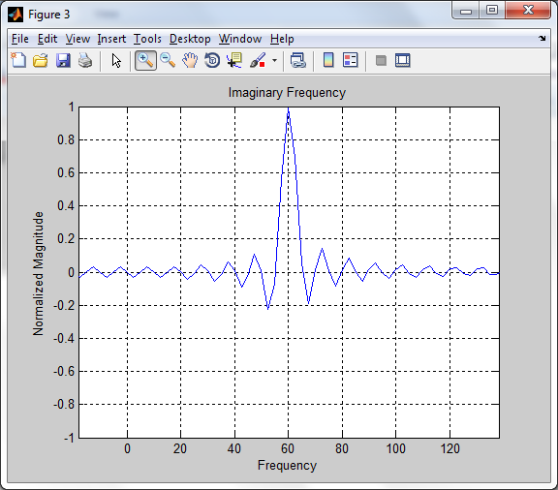
Sin Wave, Frequency 60 Hz and Phase Shift = 180
WaveForm:
Normalized FFT:
Real Component:
Imaginary Component:

Slide 7
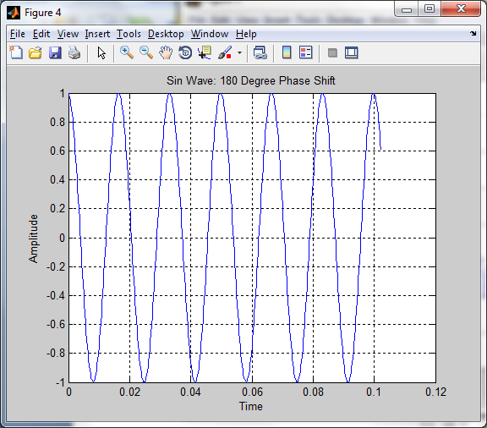
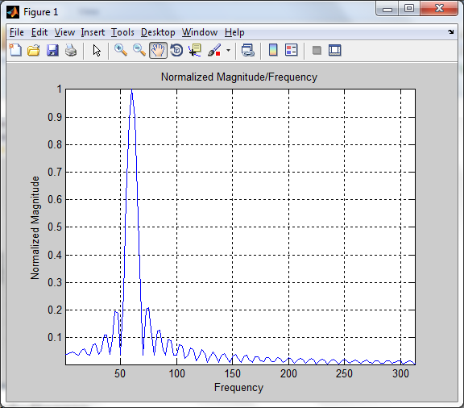
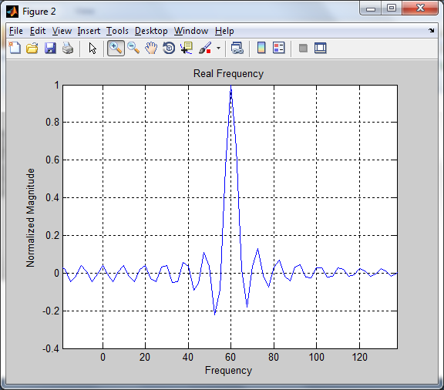
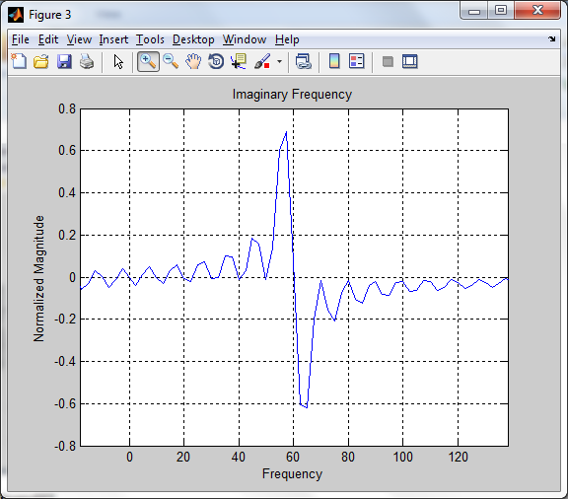
Sin Wave, Frequency 60 Hz and Phase Shift = 90
WaveForm:
Normalized FFT:
Real Component:
Imaginary Component:

Slide 8
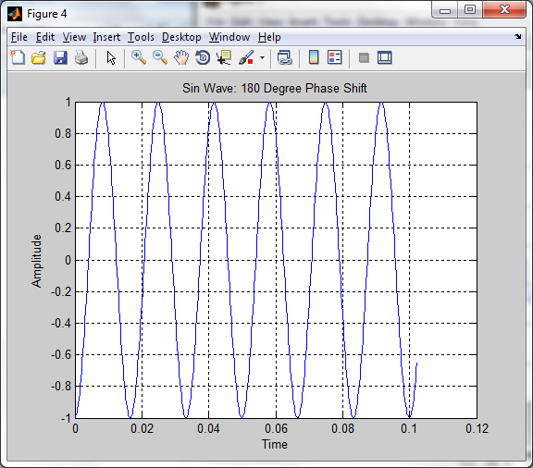
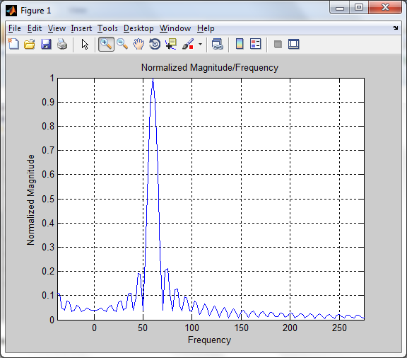
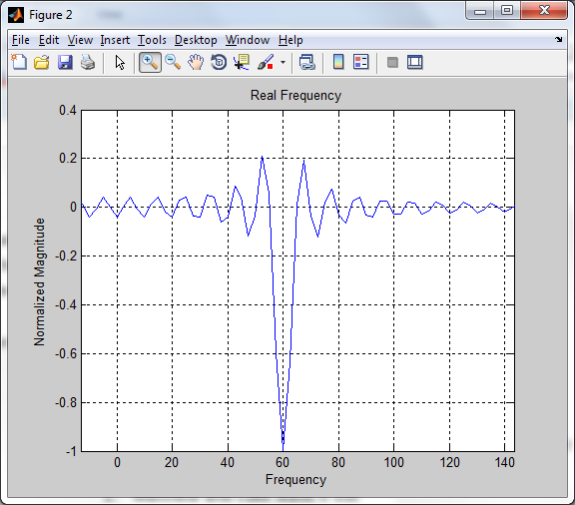
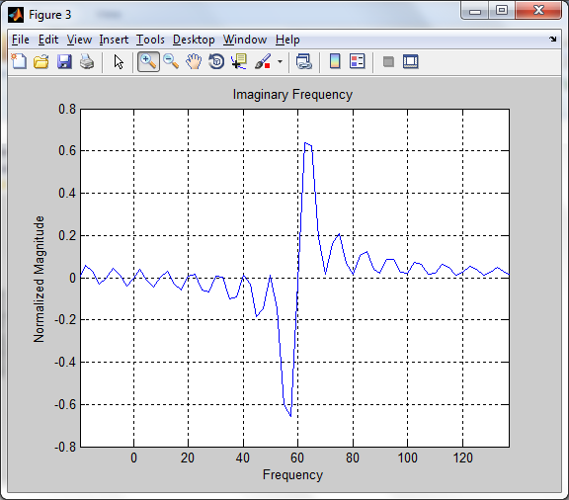
Sin Wave, Frequency 60 Hz and Phase Shift = 270
WaveForm:
Normalized FFT:
Real Component:
Imaginary Component:

Slide 9
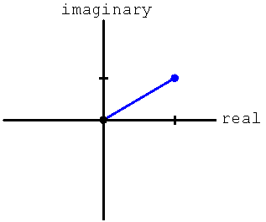

Phase θ
Normalized Value
θ

Slide 10
Data Evidence (FAN)
Starting Sample # |  | 84 | 167 | 250 | 1 | 333
Phase | 60 Hz | 1.5559 | 1.534 | 1.5117 | -1.5632 | 1.49
 | 180 Hz | -1.0878 | -0.9126 | -0.6276 | -0.9243 | -0.6064
 | 300 Hz | -1.2934 | -2.4057 | -1.5497 | -1.1978 | 1.4422
FFT | 60 Hz | 1 | 1 | 1 | 1 | 1
 | 180 Hz | 0.0046 | 0.0045 | 0.0057 | 0.0051 | 0.0059
 | 300 Hz | 0.0389 | 0.0389 | 0.0381 | 0.0405 | 0.0375
Real_FFT | 60 Hz | -0.0149 | -0.0368 | -0.059 | 0.0076 | -0.0802
 | 180 Hz | 0.0022 | 0.0027 | 0.046 | 0.0031 | 0.0049
 | 300 Hz | -0.0106 | -0.0064 | -0.008 | -0.0147 | 0.0048
Imaginary_FFT | 60 Hz | -0.9999 | -0.9993 | -0.9983 | -1 | -0.9968
 | 180 Hz | -0.0041 | -0.0035 | -0.0034 | -0.0041 | -0.0034
 | 300 Hz | 0.0374 | 0.0383 | 0.0381 | 0.0377 | 0.0371

Slide 11

Phase Shift (MATLAB)
Before Phase Shift
After Phase Shift

